Slide 1


Capturing Live Video with OpenCV in Python
Welcome to the second tutorial in our image processing series! Today we'll learn how to access your camera and process live video using Python and OpenCV.
by EMRE Akpınar

Slide 2

Setting Up Your Camera
Import Library
Create Capture Object
Understanding Parameters
First, import the OpenCV library, which gives us access to camera functions.
Use cv2.VideoCapture(0) to connect to your built-in webcam.
The parameter (0) represents your default camera. External webcams use higher numbers.

Slide 3

Capturing Frames
1
Create Infinite Loop
Use a while True loop to continuously capture camera frames.
2
Read Frames
The cap.read() function returns two values: a success flag and the image frame.
3
Display Frame
Show each captured frame using cv2.imshow() function.

Slide 4
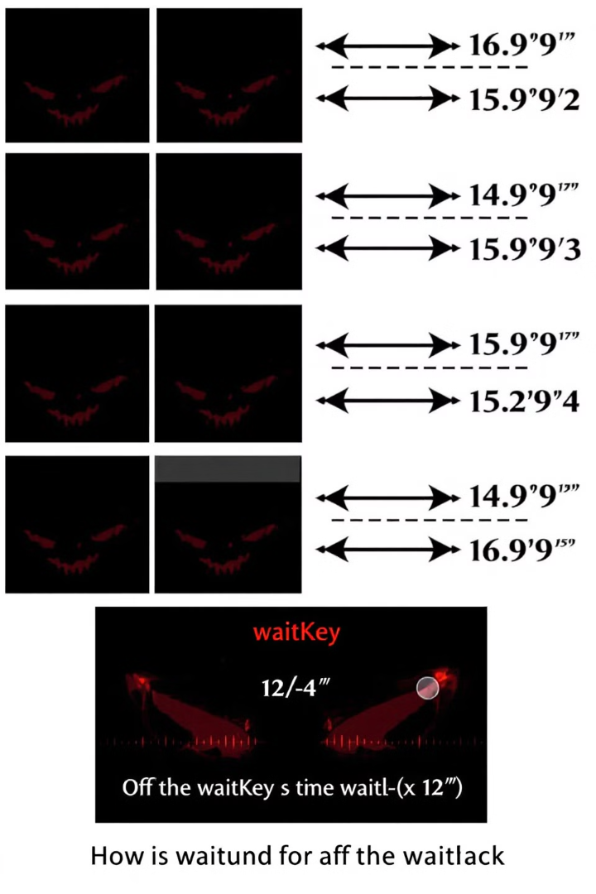



Frame Timing and Display
waitKey(1)
imshow()
Loop Concept
Sets frame refresh rate. Lower values create smoother video.
Displays each frame in a window named "Frame".
Think of this as taking many photos quickly to create video.

Slide 5

Exiting the Video Stream
Add Exit Condition
Listen for keyboard input with cv2.waitKey().
Check for 'q' Key
Use if cv2.waitKey(1) & 0xFF == ord('q'): break.
Release Resources
Call cap.release() and cv2.destroyAllWindows() when done.

Slide 6
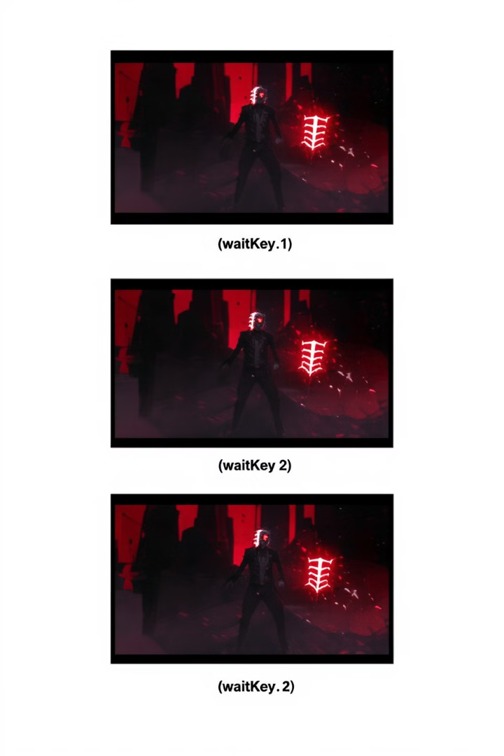
Understanding waitKey Values
0
1
Static Image
Smooth Video
Freezes the frame until a key is pressed.
Creates real-time video with minimal delay.
1000
Slow Updates
Updates once per second, creating a slideshow effect.

Slide 7





Complete Code Example
Import Library
import cv2
Create Camera Object
cap = cv2.VideoCapture(0)
Capture Loop
while True: ret, frame = cap.read(); cv2.imshow("Frame", frame)
Exit Handling
if cv2.waitKey(1) & 0xFF == ord('q'): break
Cleanup
cap.release(); cv2.destroyAllWindows()

Slide 8




Common Issues and Solutions
Camera Not Found
Lagging Video
1
Try different index numbers (1,2) for external webcams.
Ensure waitKey value is small enough for smooth playback.
2
Black Screen
4
Memory Leaks
Check camera permissions in your operating system.
3
Always release camera resources when done.

Slide 9




Next Steps in Video Processing
Advanced Effects
1
Apply filters and transformations to live video.
Object Detection
2
Identify and track objects in the video stream.
Frame Analysis
3
Extract information from individual frames.
Basic Video Capture
4
What we learned today!

